Slide 1




4 – Merge Conflicts
https://www.youtube.com/watch?v=Tyd0FO0tko8
Images from:
https://git-scm.com/downloads/logos
https://github.com/logos
Notes:
BEFORE CLASS:
- Need to merge the conflict branch right before class.
- This branch will change all of the lines that are touched by the round2 issues.
- That will change everyone’s PR from
- can be merged automatically
- to contains conflicts.
In the activity due today you
-addressed another issue
- adding a link to the README
- made a pull request for that change to the upstream.
Today we’ll do a quick overview of how you got there.
Then we will see
- What can happen when multiple changes conflict.
- We have been careful to this point to ensure that each change was independent.
- So your change did not affect anyone else's
- And theirs did not affect yours.
- But clearly with multiple people working asynchronously in a distributed community
- it is possible that concurrent changes
- by different people
- will interact in was that conflict.
- When we try to bring those changes together
- They create what is called a merge conflict.

Slide 2
Our Current State
How did we
get here?
Commit
Pull Request
Synch
Switch
Branch
Push
Stage
Edit
Notes:
This is where things stand after you have completed the prior homework.
How did we get here?
- Discuss with your neighbors…
- Place this list of terms into a plausible order.
Build the list on the board:
1. Synch
2. Branch
3. Switch
4. Edit
5. Stage
6. Commit
7. Push
8. Pull request
Note that all developers might be doing the same thing.

Slide 3
Our Current State
Demo: Look at the Pull Requests on GitHub
Notes:
This is where you were when you made your PR.
- When you finished the previous homework your PR should have said
- can be merged automatically.
- From this picture that should make sense
- your blue commit (and the fuchsia and lime ones too)
- all can be applied directly on the green one
- which is still at the head of the main branch.
But if we look at your PR’s now…
- They will say “This branch has conflicts that must be resolved”
- Show a few of their PR’s from the upstream repo to illustrate this.
Why/How did that happen?
- next slide.

Slide 4
Upstream Changes
✓
Why is there now a conflict?
Notes:
This is the state of the world now…
- What has happened?
- Maintainers (me) merged a pull request into main
- the Fuchsia commit was added.
Ask: Why do you think it created conflict?
- Just get at the idea that the blue (or lime) commit
- must have changed the same parts of the repo
- i.e. the same area of a file.
- Don’t need to be too precise here.
Truth:
- I merged a commit that changed
- all four lines that were affected by the round 2 issues.
- so that commit will create a merge conflict for everyone

Slide 5
Merging Branches: Common Ancestors
The Best Common Ancestor
is often the most recent common ancestor
A Common Ancestor is a commit that exists in both branches.
Old MacDonald had a farm
And on that farm, he had a pig
With an oink oink here
And an oink oink there
Old MacDonald had a farm
And on that farm, he had a duck
With a quack quack here
And a quack quack there
Old MacDonald had a farm
And on that farm, he had a cow
With a moo moo here
And a moo moo there
Old MacDonald had a farm
And on that farm, he had a duck
With a quack quack here
And a quack quack there
Old MacDonald had a farm
And on that farm, he had a cow
With a moo moo here
And a moo moo there
Old MacDonald had a farm
And on that farm, he had a goat
With a bahh bahh here
And a bahh bahh there
Feature Branch
Best Common Ancestor
Main Branch
Notes:
Let’s have a little closer look at the merge process
- to understand why there were no conflicts last time
- why there are conflicts this time
- and give us a foundation for understanding how we resolve them.
Here the maintainers want to merge (or blend) the changes in
- the feature branch – blue commit
- the upstream main branch – fuchsia commit
The way this works is that git uses the history to identify the best common ancestor that is shared by the two branches.
- A common ancestor is a commit that exists in both of the branches being merged.
- What are the common ancestors here?
- Both the feature branch and the main branch are derived from the Red, Yellow, and Green commits.
- So those are the common ancestors.
- Which ancestor is the best common ancestor is determined by git and is somewhat complex.
- The details of how it works are beyond the scope of these materials.
- You can find it documented elsewhere if you are interested.
- In most typical use cases the best common ancestor will be the most recent common ancestor.
- What is the best common ancestor here?
- The Green commit is the newest commit that that is shared by the branches.
- So it is the “best common ancestor”

Slide 6
Merging Branches: Identifying Changes
What changes have occurred in each branch?
Git identifies changes relative to the best common ancestor.
Old MacDonald had a farm
And on that farm, he had a pig
With an oink oink here
And an oink oink there
Old MacDonald had a farm
And on that farm, he had a duck
With a quack quack here
And a quack quack there
Old MacDonald had a farm
And on that farm, he had a cow
With a moo moo here
And a moo moo there
Old MacDonald had a farm
And on that farm, he had a duck
With a quack quack here
And a quack quack there
Old MacDonald had a farm
And on that farm, he had a cow
With a moo moo here
And a moo moo there
Old MacDonald had a farm
And on that farm, he had a goat
With a bahh bahh here
And a bahh bahh there
Feature Branch
Best Common Ancestor
Main Branch
Notes:
Next
- git will compare the branches being merged to the best common ancestor
- and identify the changes that have occurred in each of the branches involved in the merge.
What changes do you see?

Slide 7
Non-Conflicting Changes
Non-conflicting changes can be merged automatically.
Changes can be conflicting
or
non-conflicting.
Old MacDonald had a farm
And on that farm, he had a pig
With an oink oink here
And an oink oink there
Old MacDonald had a farm
And on that farm, he had a duck
With a quack quack here
And a quack quack there
Old MacDonald had a farm
And on that farm, he had a cow
With a moo moo here
And a moo moo there
Old MacDonald had a farm
And on that farm, he had a duck
With a quack quack here
And a quack quack there
Old MacDonald had a farm
And on that farm, he had a cow
With a moo moo here
And a moo moo there
Old MacDonald had a farm
And on that farm, he had a goat
With a bahh bahh here
And a bahh bahh there
Feature Branch
Best Common Ancestor
Main Branch
Notes:
The changes in a commit are colored and underlined:
- The changes in the feature branch are in blue (cow and moo were changed to pig an oink)
- The changes in the main branch are in fuchia (duck and quack were changed to goat and bahh)
The changes can be:
- Non-conflicting
- Conflicting
Ask:
- Do you think the current changes are conflicting or non-conflicting?
- why?
Ask:
- What would make changes conflicting?
- if blue had changed duck or quack.
- if fuchsia had changed cow or moo
The idea of conflicting and non-conflicting changes is
- intuitively simple
- roughly… not on the same line
- much more complicated in practice
- we will not go into it and will assume it is line based.
Non-conflicting changes can be merged automatically.
- There is no confusion about what change to pick, because there is no conflict.
- Thus git can perform this merge for us.
- The managers of the upstream will do this
- It is what we saw happen with your PR’s in the last activity.

Slide 8
Merge Commits
A
merge commit adds or blends changes from two parent commits.
Time
main
hasPig
Old MacDonald had a farm
And on that farm, he had a pig
With an oink oink here
And an oink oink there
Old MacDonald had a farm
And on that farm, he had a duck
With a quack quack here
And a quack quack there
Old MacDonald had a farm
And on that farm, he had a pig
With an oink oink here
And an oink oink there
Old MacDonald had a farm
And on that farm, he had a goat
With a bahh bahh here
And a bahh bahh there
Old MacDonald had a farm
And on that farm, he had a cow
With a moo moo here
And a moo moo there
Old MacDonald had a farm
And on that farm, he had a goat
With a bahh bahh here
And a bahh bahh there
8
Feature Branch
Merged Result
Main Branch
8
Notes:
When two branches are merged
- A merge commit is added to the target branch
- In this case we are showing an automatic merge of a feature branch into the main branch.
- Again, this is what the maintainers will do when your branch has no conflicts.
- Is what happened with your “Round1” issues when they were merged in the previous activity.
When changes don’t conflict
- and the merge happens automatically
- the merge commit will just add the changes from the feature branch
- the white ring indicates that the merge commit is slightly different than the original blue commit.
- will have a different time stamp, a different id (hash) and information about who did the merge.
- notice that the fuchsia changes are already in main so they are not in the merge commit
- Recall that a commit just contains the changes since the prior commit.
Having a merge commit makes it clear where the changes came from.
- part of the history.
- preserves the fact that a branch was merged
- where the branch came from
- what commits it contained
- when it was merged
- who merged it.
NOTE:
- This skirts the issue of what happens when there are multiple commits on the feature branch.
- What we show here is conceptually compatible with a squash and merge
- Squash and merge, compresses all commits in the feature branch into a single merge commit.
- This is a common strategy for keeping project history simple.
- Different project and different organizations will use different approaches in the case where there are multiple commits in the feature branch being merged.

Slide 9
Conflicting Changes
What makes these conflicting changes?
What changes have occurred here?
Old MacDonald had a farm
And on that farm, he had a cow
With a moo moo here
And a moo moo there
Old MacDonald had a farm
And on that farm, he had a pig
With a oink oink here
And a oink oink there
Old MacDonald had a farm
And on that farm, he had a cow
With a moo moo here
And a moo moo there
Old MacDonald had a farm
And on that farm, he had a duck
With a quack quack here
And a quack quack there
Old MacDonald had a farm
And on that farm, he had a cow
With a moo moo here
And a moo moo there
Old MacDonald had a farm
And on that farm, he had a piglet
With an oinky oink here
And an oinky oink there
Feature Branch
Best Common Ancestor
Main Branch
Notes:
What changes have occurred here?
- In the feature branch “duck” and “quack quack” have changed to “pig” and “oinky oink”
- In the main branch “duck” and “a quack quack” have changed to “piglet” and “an oink oink”
A merge conflict occurs when
- There is no way for git to know what the intended result is.
- should it be a pig or a piglet?
- should it be a oinky oink or an oink oink?
- We may know
- but git cannot know.
- So this must be resolved manually.

Slide 10
Merge Conflicts
Merge Conflicts
must be resolved manually.
Conflicting changes create Merge Conflicts
Old MacDonald had a farm
And on that farm, he had a cow
With a moo moo here
And a moo moo there
Old MacDonald had a farm
And on that farm, he had a pig
With a oink oink here
And a oink oink there
Old MacDonald had a farm
And on that farm, he had a cow
With a moo moo here
And a moo moo there
Old MacDonald had a farm
And on that farm, he had a duck
With a quack quack here
And a quack quack there
Old MacDonald had a farm
And on that farm, he had a cow
With a moo moo here
And a moo moo there
Old MacDonald had a farm
And on that farm, he had a piglet
With an oinky oink here
And an oinky oink there
Feature Branch
Best Common Ancestor
Main Branch
Notes:
Conflicting changes are shown with highlighting in addition to the color changes and underlining.
When there are conflicting changes, we get “Merge Conflicts”
- That is there is a conflict between the changes that are being merged.
A merge conflict occurs when:
- There is no way for git to know what the intended result is.
- should it be a pig or a piglet?
- should it be a oinky oink or an oink oink or an oinky oink?
- We may know
- but there is no way for git to know.
- the right choice depends on meaning.
- So this type of conflict must be resolved manually.
Now the project managers could take the time to do this…
- But
- they are busy people
- and you are the expert on the changes you are adding
- So
- usually you will be asked to fix this.
- That is also compatible with the idea that
- The current main branch should be the starting point for all new work.
- Basically, it is your responsibility to ensure that your changes are compatible with the current state of the main branch.
So what do you do?
- Synch and merge the changes in main into your feature branch.

Slide 11
Synch with Upstream Main
1. switch to main
2. pull from upstream
3. push to origin
Notes:
In order to resolve the merge conflict you will need to
- Get the updates to the upstream main
- into your local repo
- also good idea to push to origin
- just to keep everything in synch.
Then you will resolve the merge conflict
- in your local repo
- on your machine
- then push the result up to your origin

Slide 12
Resolving a Merge Conflict
Upstream changes are merged from main into your feature branch.
Time
main
hasPig
Old MacDonald had a farm
And on that farm, he had a cow
With a moo moo here
And a moo moo there
Old MacDonald had a farm
And on that farm, he had a pig
With a oink oink here
And a oink oink there
Old MacDonald had a farm
And on that farm, he had a cow
With a moo moo here
And a moo moo there
Old MacDonald had a farm
And on that farm, he had a piglet
With an oink oink here
And an oink oink there
Old MacDonald had a farm
And on that farm, he had a cow
With a moo moo here
And a moo moo there
Old MacDonald had a farm
And on that farm, he had a piglet
With an oinky oink here
And an oinky oink there
12
Feature Branch
Merged Result
Main Branch
12
Notes:
With the upstream changes now in the main branch in your local repo
You resolve the conflict by
- merging the changes
- from the main branch
- into your feature branch
For example, here:
- piglet is taken from main (because piglets are cute)
- the line “an oink oink” is blended from the two commits:
- an is taken from the main branch (because it is better grammatically).
- oink oink is taken from the feature branch (because the sounds are always the same in the song).
- The merge commit not used a blending of the two colors to indicate the merge.
- I.e. not a white ring like in the automatic merge earlier.
- The merge commit is then added to the end of your feature branch.
Might seem backwards
- We want the changes in main
- Ask: Why not merge into the main branch?
- recall that we don’t ever merge into main
- we leave that to the maintainers
- If we don’t, then we get into the problem were we can’t fast forward our main branch from the upstream.
By doing the merge
- We have told git how we want conflicts between the blue and fuchsia commits to be resolved.
- The blue/fuchsia merge commit contains that information.
- Doing so ensures that the maintainers will now be able to merge the feature branch automatically.

Slide 13
Practice: Identifying Changes
Identify the conflicting and non-conflicting changes.
x = [ 1, 5, 3, 9, 2 ]
max = x[0]
for n in x:
if n >= max:
max = x
print max
x = [ 1, 5, 3, 9, 2 ]
m = x[0]
for n in x:
if n >= m:
m = n
print m
x = [ 1, 5, 3, 9, 2 ]
m = x[0]
for n in range(1:length(x)):
if x[n] > m:
m = x[n]
print m
Feature Branch
Best Common Ancestor
Main Branch
Notes:
For practice:
- Consider this small python program…
- What is it trying to do?
Use these branches and the given best common ancestor.
- Identify all of the non-conflicting and conflicting changes that exist in the feature branch and the main branch.
One good approach:
- Identify all of the changes between
- the feature branch and best common ancestor.
- the main branch and best common ancestor.
- Then identify any conflicting changes
- lines that have changed in both the feature branch and the main branch.
Again… just using lines here is a little bit of an oversimplification of the process that git uses to find conflicts.
- but it is conceptually accurate enough for most purposes.
- the exact details are beyond the scope of these materials.
- the details are documented elsewhere if you are interested.

Slide 14
Practice: Identifying Changes
Identify the conflicting and non-conflicting changes.
x = [ 1, 5, 3, 9, 2 ]
max = x[0]
for n in x:
if n >= max:
max = x
print max
x = [ 1, 5, 3, 9, 2 ]
m = x[0]
for n in x:
if n >= m:
m = n
print m
x = [ 1, 5, 3, 9, 2 ]
m = x[0]
for n in range(1:length(x)):
if x[n] > m:
m = x[n]
print m
Feature Branch
Best Common Ancestor
Main Branch
Notes:
All changes are colored (orange or green) and underlined.
All conflicting changes are also highlighted in red.

Slide 15
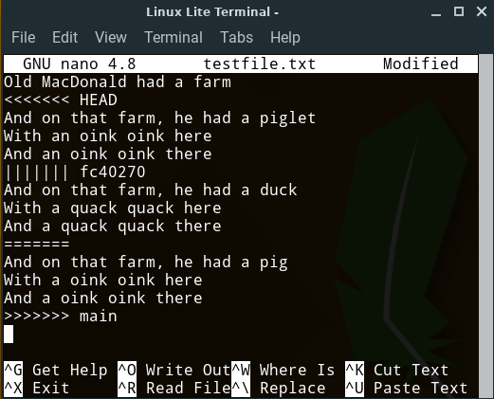
Raw Merge Conflicts
Feature
Branch
“Chevrons”
<<<<<<
>>>>>>
Best Common
Ancestor
main
Branch
Notes:
When a merge conflict occurs
- git will place text directly into the conflicting files
- to represent the conflict
Note that the content here does not correspond exactly with the prior examples…
- but it still illustrates how merge conflict information is displayed in the text files.
Ask
- What do you think we are seeing here?
- the three versions of the conflicting content
- the feature branch
- the best common ancestor
- the main branch
The conflict is indicated by
- “Chevrons”
- Aligned V shapes
- Often on military uniforms to indicate rank
- also often used for directional road markings.
The other symbols
- ||||||| fc40270
- the SHA of the best common ancestor
- ======
- just a divider before the main branch.
You can simply edit the file:
- Open it in any editor you want
- Make everything between the chevrons look the way you want.
- Just edit it down to the correct blended version.
- Remove the chevrons
- Save and exit

Slide 16
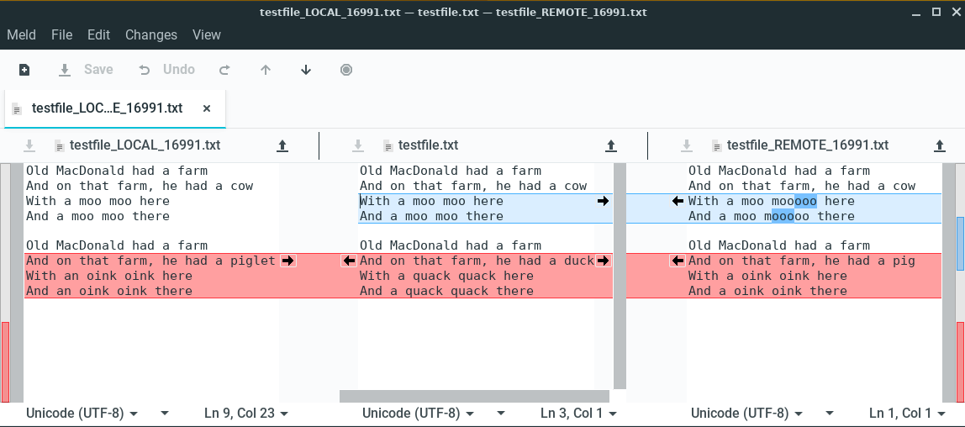
Using a Graphical Merge Tool (e.g. Meld)
Ancestor /
Result
Feature Branch
Main Branch
Notes:
The GUI merge tool will display the same information
In a way that makes it a little easier to work with.
Colors:
- red indicates conflicts
- blue indicates changes but not conflicting
Action:
- Goal is to make the middle pane into what you want
- click arrows to move changes to the middle pane.
- edit the middle pane directly
- Save
- Exit
Another nice thing about the GUI tool is if there are multiple conflicts
- the Up and Down arrows at the top
- will move you to the next or previous conflict.
Most IDE’s will have some sort of integrated merge tool.
- Eclipse, VSCode/VSCodium
- whatever you happen to use.
- They all display the same information
- Just in slightly different ways.

Slide 17
Big Picture: Resolving a Merge Conflict
Notes:
Here we just have it all together.
- we already synchronized
- we switch to the feature branch
- perform the merge to resolve the conflict
- Note that this will mean that you have changed the local files!
- Edited them by hand
- or used a GUI tool
- So these changes need to be staged and committed.
- stage the changes
- commit the changes
- push the feature branch
- recall that this will automatically update the PR
- and now it will be able to be merged automatically.
This is where you will want to get to by the end of the activities for this topic.

Slide 18
Big Picture: The Whole Messy Thing
Notes:
No need to spend much time here.
If you can look at this and remember
- what each of the yellow terms means
- how it relates to the others
- sequence them into a workflow
Then you are in good shape.
- if not keep this handy
- review a little
- make more sense of it little by little.

Slide 19

Acknowledgments:
Slide Template From:
https://creativecommons.org/licenses/by/4.0/
Slide Content Licensed as:
https://creativecommons.org/licenses/by-nc/4.0/

